Slide 1
Extend power point
An addition to our orientation power point
By: Griffin goedde and Samantha soriano

Slide 2
about
In this power point I will teach you how to take picture files off a camera and move them to a power point or flash drive.
This is important because In any engagement that is In the real world an not in a computer program will require pictures of what you are doing.

Slide 3
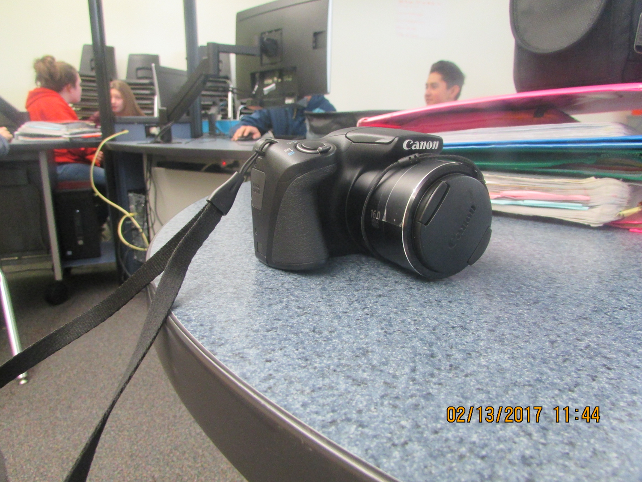
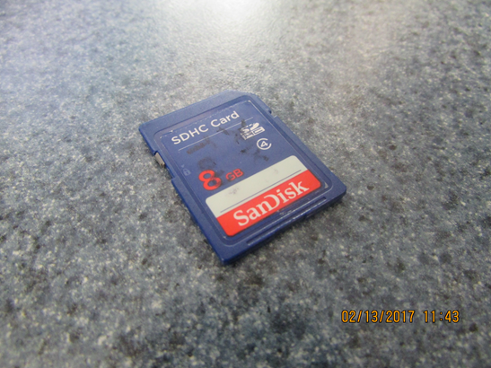
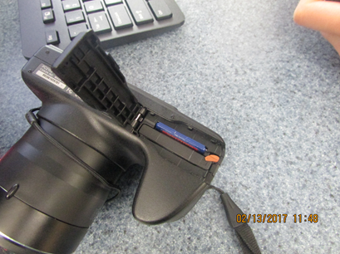
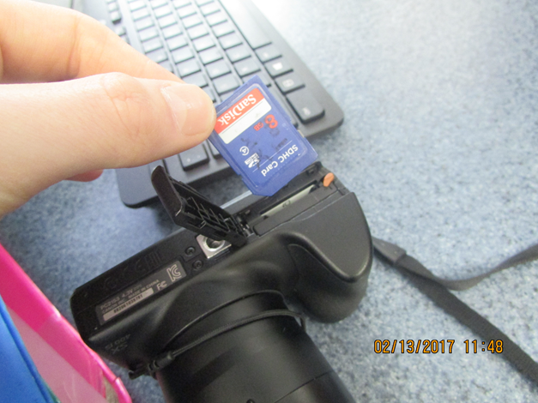
About the camera sd
A camera stores pictures and video on a chip called an SD card
This is a camera

Slide 4
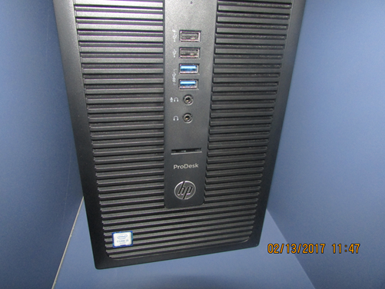
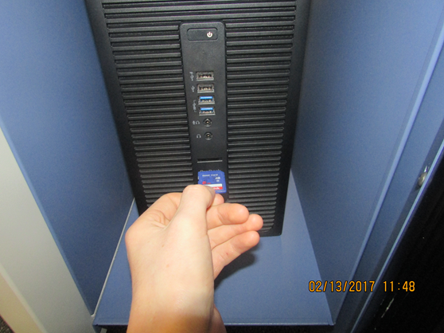
About the new computer tower
This year in stem lab we have new computer towers, instead of having a usb converter you can put the SD card directly into the tower

Slide 5
Steps 1 & 2
Turn off the camera using the on/off button on the top of the camera
Next, eject the SD card by lightly pressing it in then releasing

Slide 6
Step 3
After you have taken the SD card out of the camera you can put the SD card into the computer tower.

Slide 7
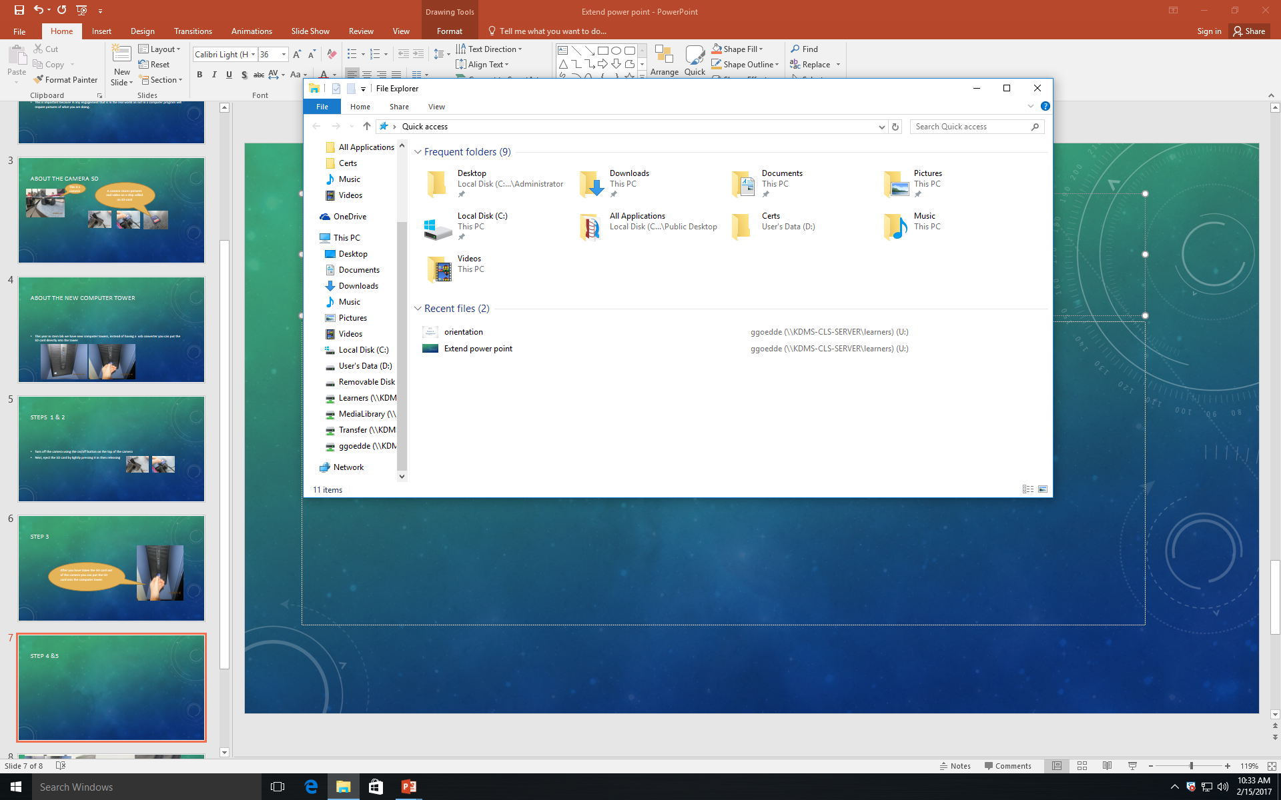
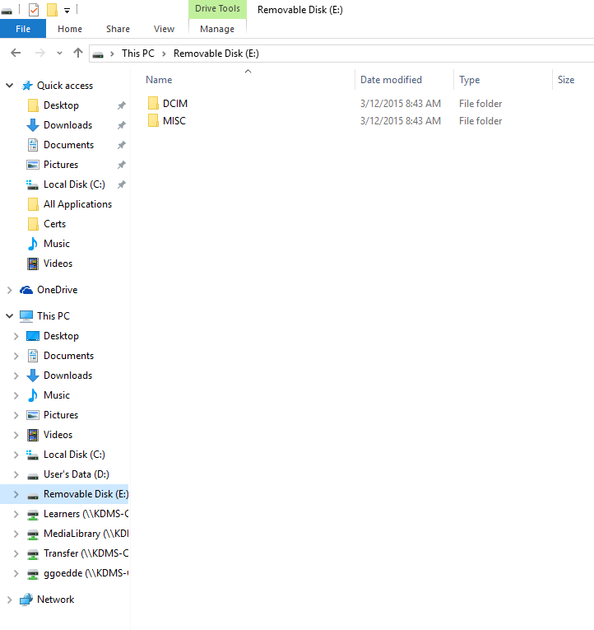
Steps 4 &5
Once you insert the SD card into the tower, go to files and it should pop up as “Removable Disk”
Once you click on the removable disk file you should select the “DCIM” folder

Slide 8
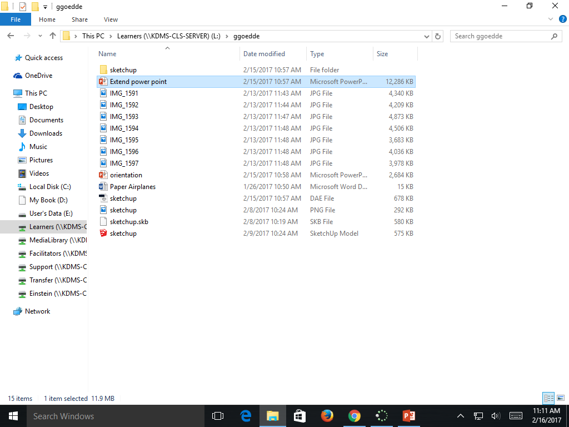
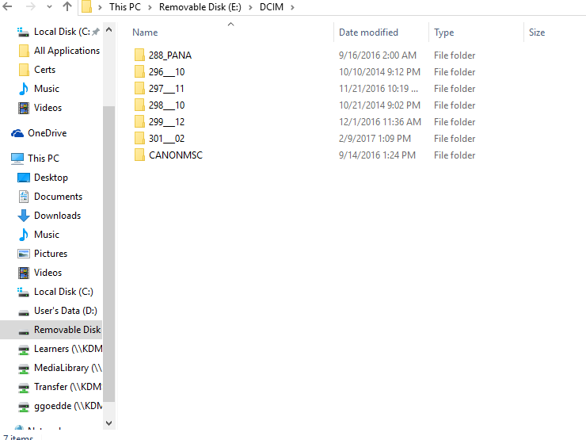
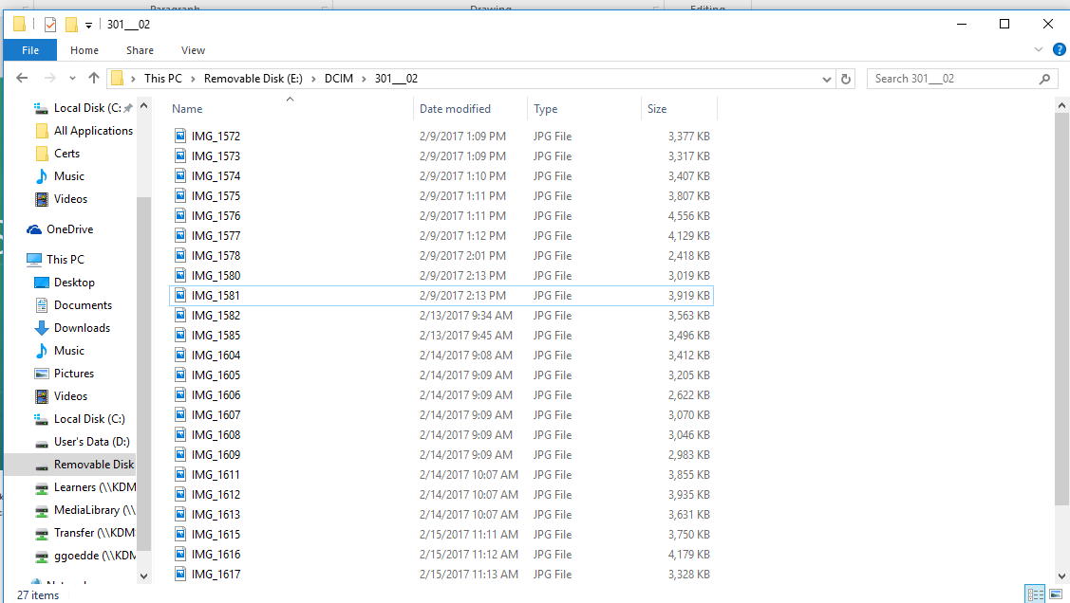
Steps 6 & 7
Once you’ve selected the “DCIM” folder, click on the folder with the date that is the day you used the camera.
(in this case its 2/9/2017)
Now, select the photo files from around the time that you took the pictures
Click the small picture icon in the bottom corner and it will show pictures of the files, making it easier to find the picture you’re looking for.

Slide 9
Step 8
Now, after you know what photo files you want, you can highlight the ones you want then click and drag them into your learners drive.

Slide 10
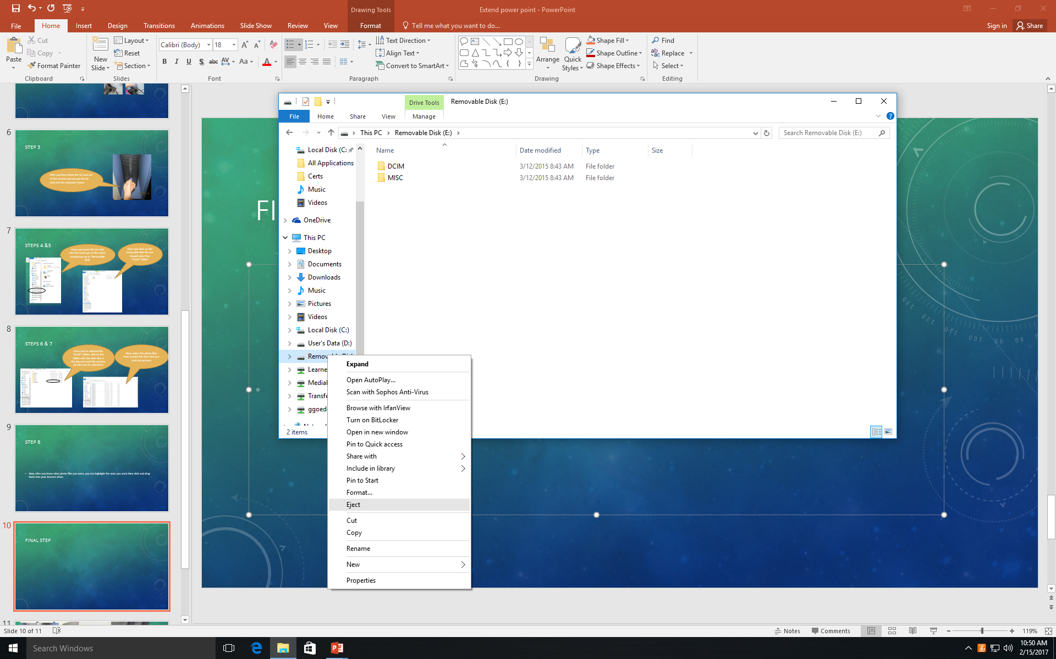
Final step
Once you are done with the SD card, right click “Removable disk” then click eject. Remove the SD card from the computer and return it to the camera.

